Slide 1

Eelo University Faculty of Computer Science and Business Technologies Course: Web Designing
Instructor: Abdurrahman Ahmed
Web Administrator, EU

Slide 2
Chapter Four
Using Html Tables

Slide 3
Defining a Table Structure
The first step to creating a table is to specify the table structure:
the number of rows and columns
the location of column headings
the placement of a table caption
Once the table structure is in place, you can start entering data into the table.

Slide 4
Using the <table>, <tr>, and <td> Tags
Graphical tables are enclosed within a two-sided <table> tag that identifies the start and ending of the table structure.
Each row of the table is indicated using a two-sided <tr> (for table row).
Within each table row, a two-sided <td> (for table data) tag indicates the presence of individual table cells.

Slide 5

The General Table Syntax
<table>
<tr>
<td> First Cell </td>
<td> Second Cell </td>
</tr>
<tr>
<td> Third Cell </td>
<td> Fourth Cell </td>
</tr>
</table>
two rows
two columns

Slide 6
Columns within a Table
HTML does not provide a tag for table columns.
In the original HTML specifications, the number of columns is determined by how many cells are inserted within each row.
for example, if you have four <td> tags in each table row, that table has four columns
Later versions of HTML provide increased support for controlling the appearance of table columns.

Slide 7
HTML Structure of a Table
beginning of the table structure
table cells
You do not need to indent the <td> tags or place them on separate lines, but you may find it easier to interpret your code if you do so.
After the table structure is in place, you’re ready to add the text for each cell.
first row of five in the table
end of the table structure

Slide 8
Creating Headings with the <th> Tag
HTML provides the <th> tag for table headings.
Text formatted with the <th> tag is centered within the cell and displayed in a boldface font.
The <th> tag is most often used for column headings, but you can use it for any cell that you want to contain centered boldfaced text.

Slide 9
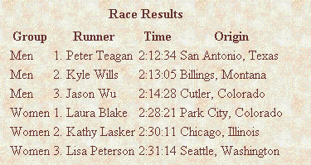
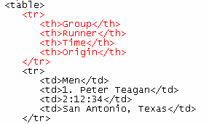
Adding Table Headings to the Table
Text in cells formatted with the <th> tag is bold and centered above each table column.
table headings

Slide 10
Creating a Table Caption
HTML allows you to specify a caption for a table.
The syntax for creating a caption is: <caption align=“alignment”>caption text</caption>
alignment indicates the caption placement
a value of “bottom” centers the caption below the table
a value of “top” or “center” centers the caption above the table
a value of “left” or “right” place the caption above the table to the left or right

Slide 11
Table Captions
Only Internet Explorer supports all caption values.
Netscape supports only the “top” and “bottom” values.
The <caption> tag works only with tables, the tag must be placed within the table structure.
Captions are shown as normal text without special formatting.
Captions can be formatted by embedding the caption text within other HTML tags.
for example, place the caption text within a pair of <b> and <i> tags causes the caption to display as bold and italic

Slide 12
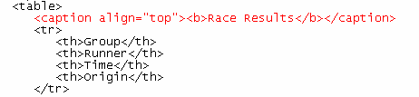
Result of a Table Caption
caption text
caption will be centered above the table

Slide 13
Modifying the Appearance of a Table
You can modify the appearance of a table by adding:
Gridlines or borders
background color
HTML also provides tags and attributes to control the placement and size of a table.

Slide 14
Adding a Table Border
By default, browsers display tables without table borders.
A table border can be added using the border attribute to the <table> tag.
The syntax for creating a table border is: <table border=“value”>
value is the width of the border in pixels
The size attribute is optional; if you don’t specify a size, the browser creates a table border 1 pixel wide.

Slide 15
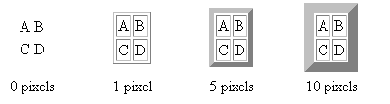
Tables with Different Borders Values
This figure shows the effect on a table’s border when the border size is varied.

Slide 16
Lets Code

Slide 17

END OF CHAPTER 4

